Slide 1
Divide and Conquer
Karatsuba faster Integer multiplication algorithm

Slide 2
Karatsuba faster integer multiplication algorithm

Slide 3


Slide 4
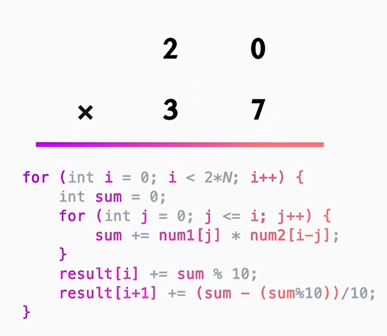

Slide 5
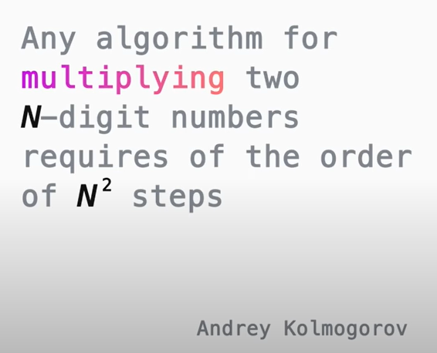

Slide 6
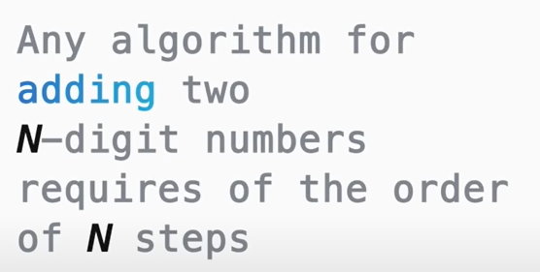

Slide 7
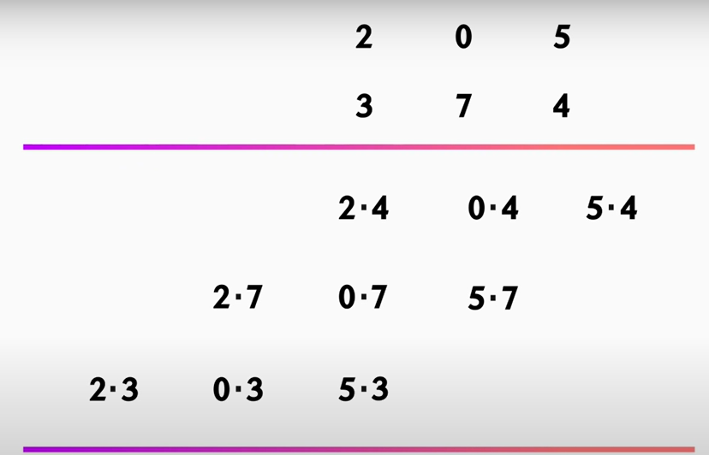
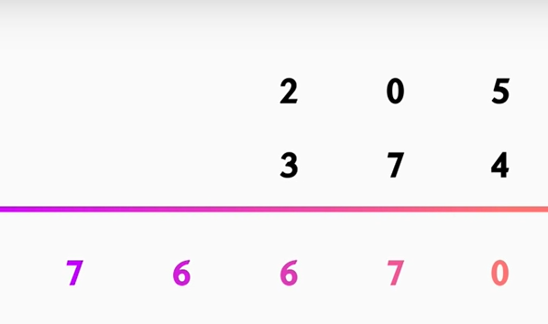
Multiplication

Slide 8
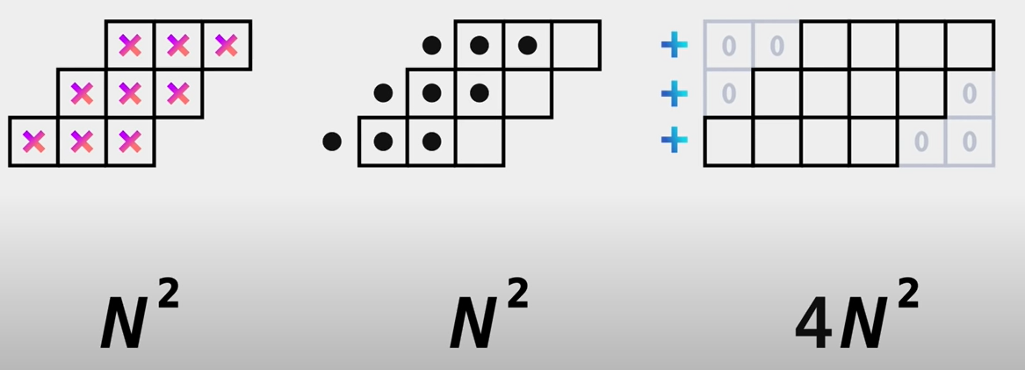

Multiplication Carry Additions

Slide 9
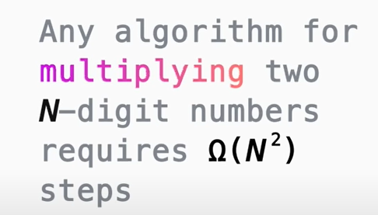

Slide 10
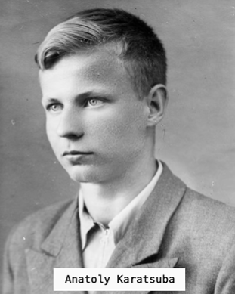

Slide 11
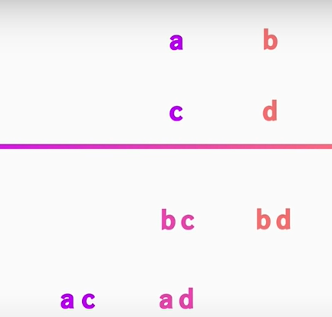
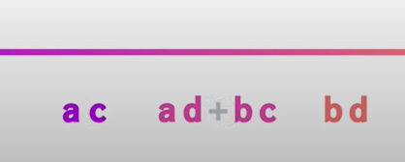

Slide 12
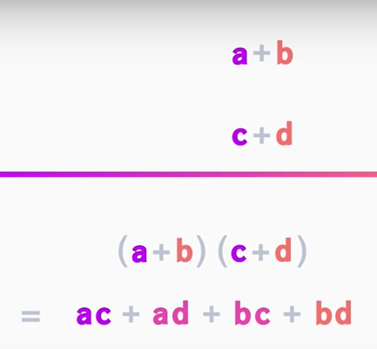

Slide 13
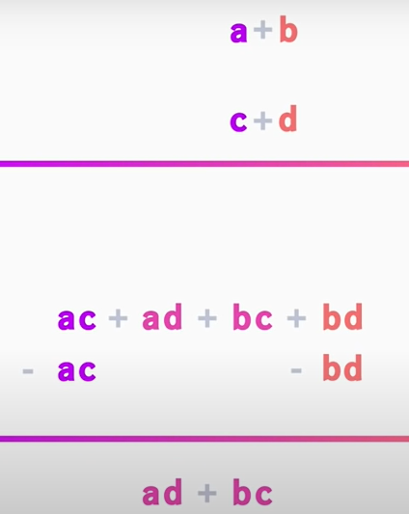

Slide 14
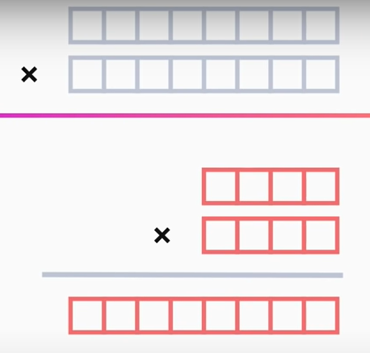

Slide 15
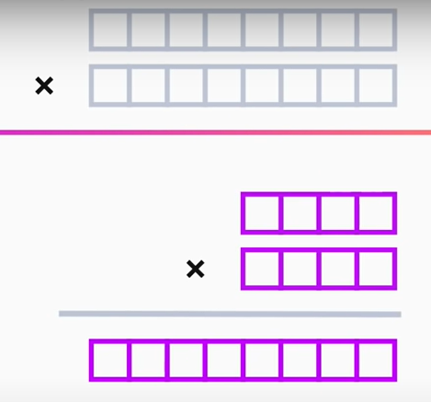

Slide 16
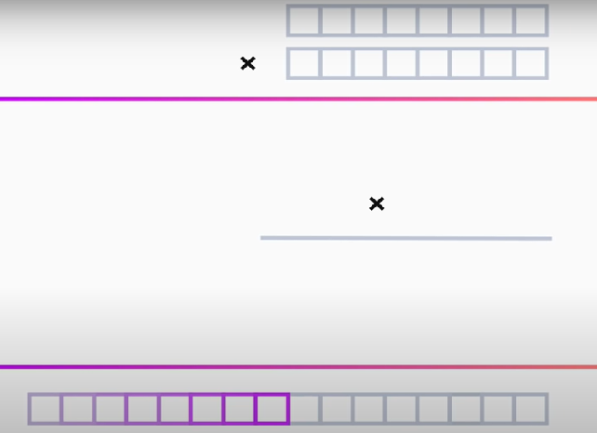

Slide 17
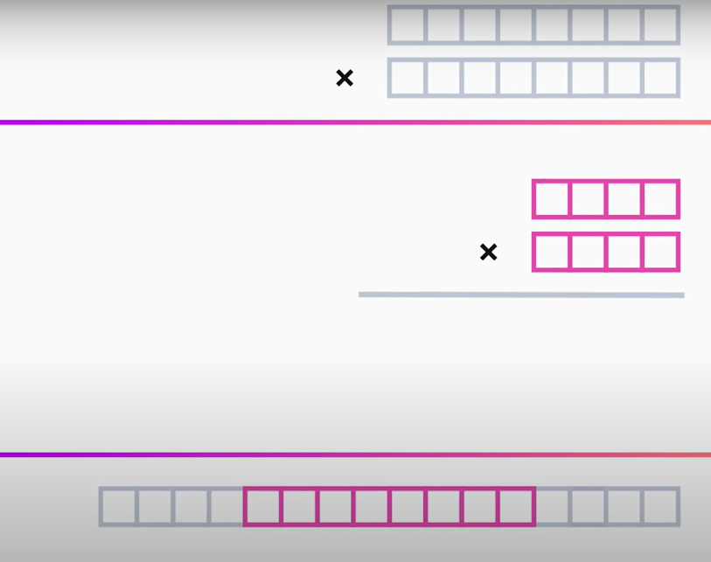
Middle terms

Slide 18
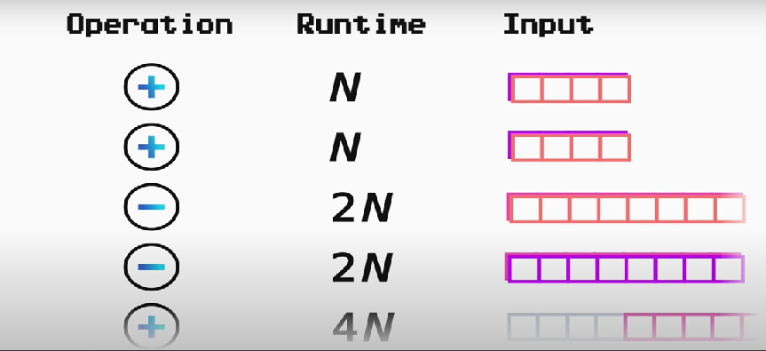


Slide 19


Slide 20
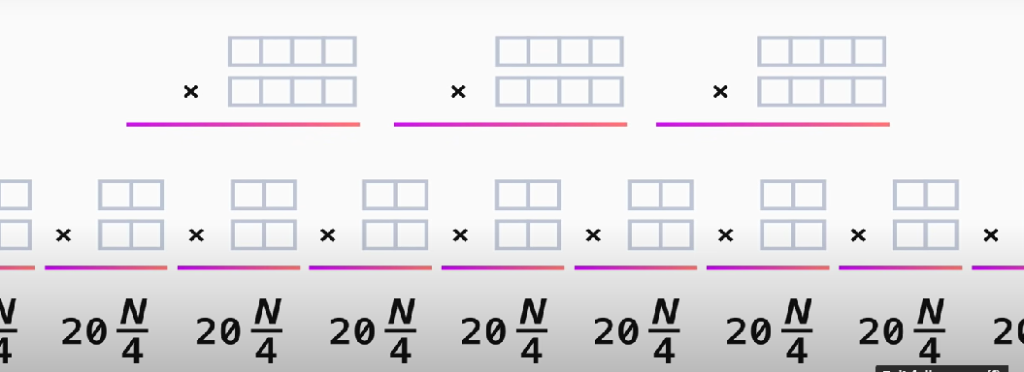

Slide 21





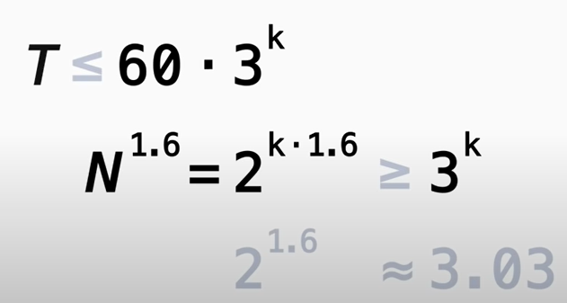

Log(3)= 1.58

Slide 22
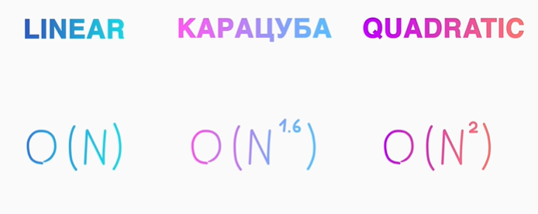

Slide 23
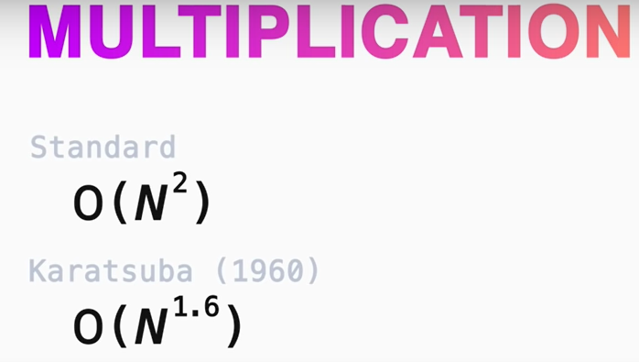
Reference 1: https://www.youtube.com/watch?v=cCKOl5li6YM
Reference 2 :https://www.youtube.com/watch?v=-dfsxsiGoC8

Slide 24
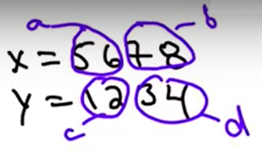
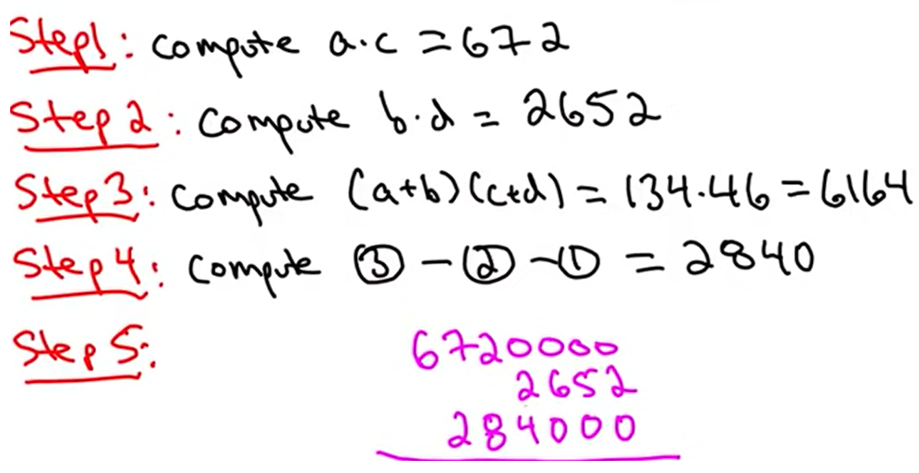

Slide 25
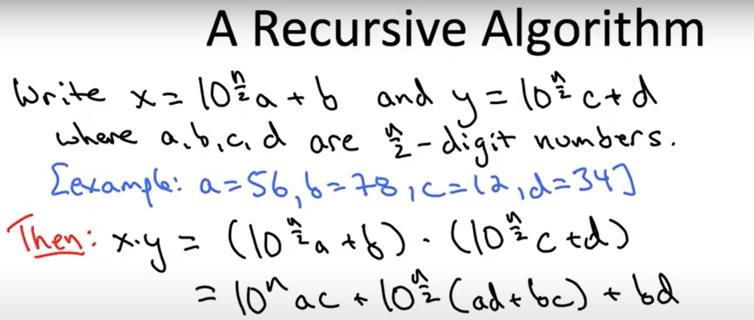

Slide 26
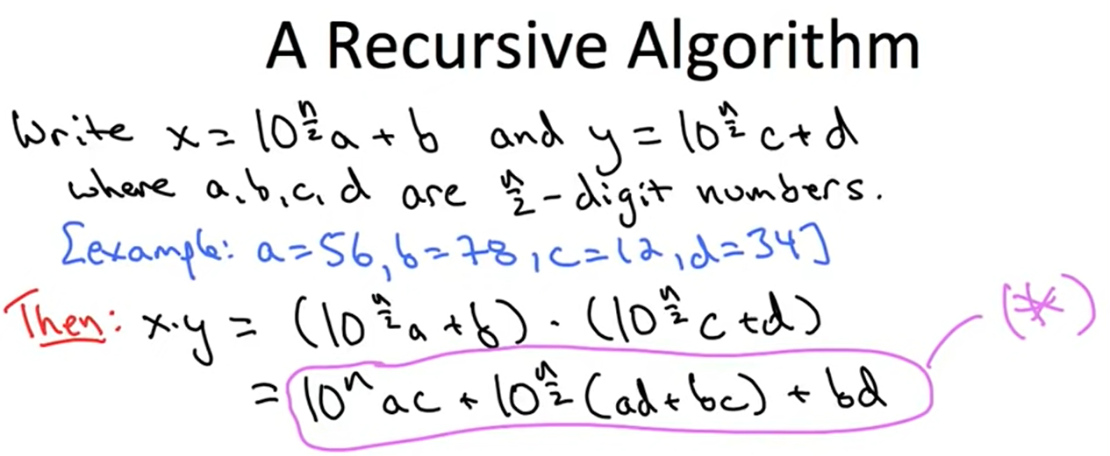
Idea : Recursively compute ac, ad, bc and bd then compute * in the straight forward way

Slide 27
We just pad a times c with n zeros at the end.
Add bd
We add ad and bc and pad the result with N over two zeros, and
then just sum up all these returns

Slide 28
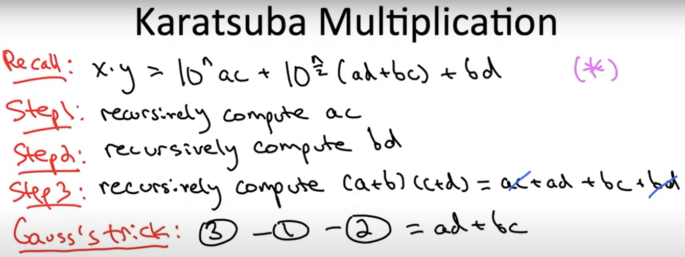
Upshot : Only Need 3 recursive multiplications and some additions

Slide 29
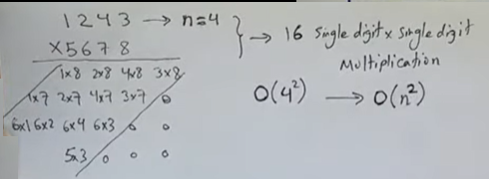
Method 2

Slide 30
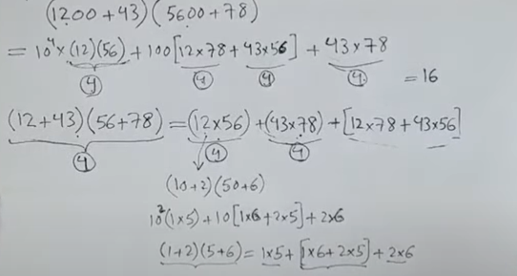

Slide 31
